Slide 1

BRIGHT COFFEE SHOP
Sales Analysis
Prepared by: Vuyile Jongile
Module: Data Analytics Case Study
Submission Date: 7 August 2026

Slide 2

business problem
Objective
The purpose of this project was to analyse Bright Coffee Shop's sales data to identify revenue trends, customer purchasing patterns, and peak trading periods. The analysis aims to provide actionable recommendations that will help management improve sales performance and make data-driven business decisions.

Slide 3
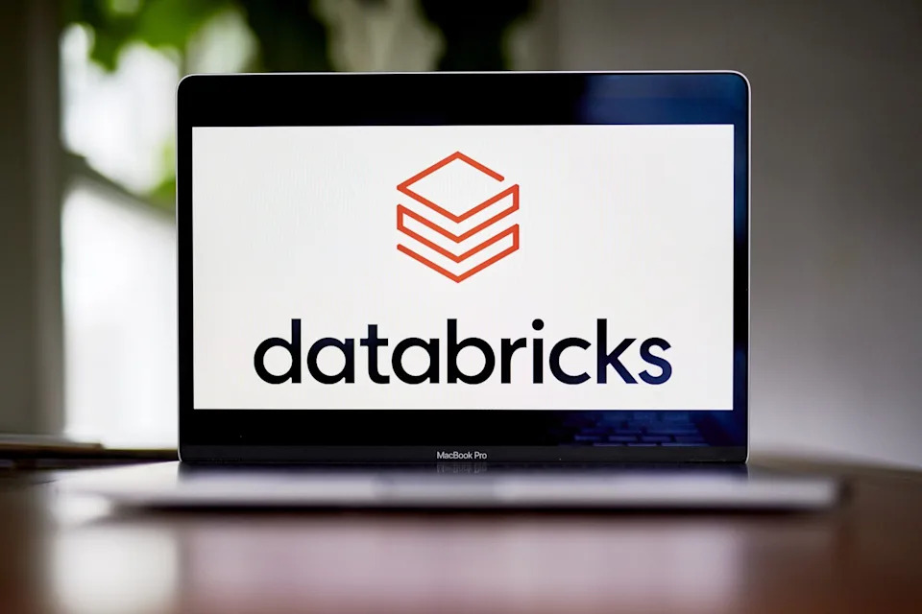
Data cleaning and tranformation
Imported the Bright Coffee Shop sales dataset into Databricks.
Converted the unit price column from text to decimal format. Created a total amount column by multiplying transaction quantity by unit price.
Created transaction time bucket to group transactions into time periods.
Exported the cleaned dataset for dashboard development.

Slide 4

Tools utilised:
Databricks FreeEdition – Data cleaning and SQL analysis.
SQL – Data transformation and business analysis.
Microsoft Excel 2016 – Pivot Tables, charts, and dashboard.
GitHub – Project submission and version control.

Slide 5
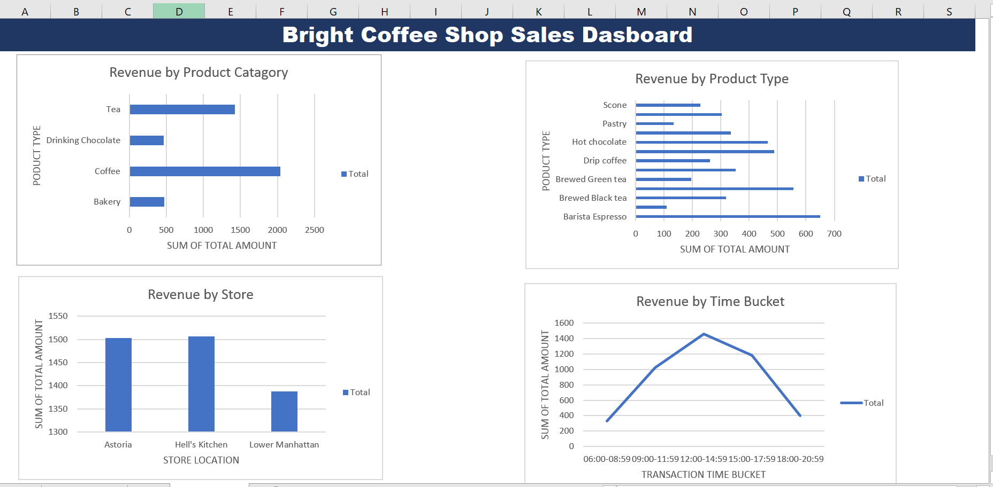
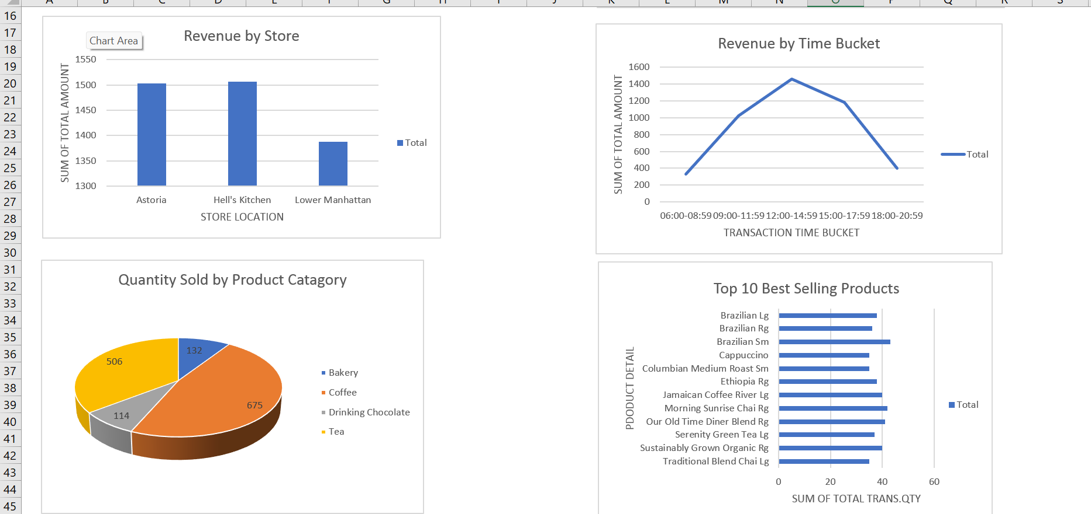
Dashboard overview

Slide 6

Key Findings
Coffee generated the highest total revenue among all product categories, making it the strongest contributor to overall sales.
Within the product types, Barista Espresso recorded the highest revenue, followed by Brewed Green Tea and Hot Chocolate, indicating strong customer demand for these beverages.
Hell's Kitchen generated the highest total revenue among the three store locations, with Astoria performing similarly, while Lower Manhattan recorded the lowest revenue.
Sales reached their highest level during the 12:00–14:59 time bucket, showing that lunchtime is the busiest trading period. Sales were lowest during the 06:00–08:59 and 18:00–20:59 periods.
Coffee had the highest quantity sold, followed by Tea, confirming that hot beverages are the most popular products.
The best-selling products included Brazilian Small, Morning Sunrise Chai, Our Old Time Diner Blend, and Brazilian Large, demonstrating consistent customer preference for coffee-based drinks.

Slide 7

recommendations
Business Recommendations
Increase inventory for high-demand products.
Introduce promotions during quieter trading periods.
Bundle slow-selling products with popular items.
Focus marketing campaigns during peak trading hours.
Use dashboards for continuous sales monitoring.
Introduce customer loyalty programmes to encourage repeat purchases.

Slide 8

Recommendations
Ensure adequate stock is maintained for the most popular coffee products to avoid running out of high-demand items and to improve customer satisfaction.
Increase staff availability during the midday trading period (12:00–14:59) to provide faster service and effectively manage the higher customer volume.
Implement targeted marketing initiatives at the Lower Manhattan branch to attract more customers and improve overall sales performance.
Encourage sales of lower-performing products by offering special promotions, meal combinations, or limited-time discounts to increase customer interest.
Use sales dashboards and regular performance reports to track business trends, evaluate performance, and support informed management decisions.
Develop a customer rewards programme to strengthen customer loyalty, encourage repeat visits, and increase long-term profitability
Final Recommendation:
By adopting these strategies, Bright Coffee Shop can improve operational efficiency, maximise revenue opportunities, enhance the customer experience, and support sustainable business growth through informed, data-driven decision-making.

